Slide 1
Emergency Locator
SOS Help
Because “Zindagi Na Milegi Doobara” !!

Slide 2
Why We Care?
Recently, Chennai was struck by floods and massive amount of devastation was caused. This lead us to think –
How can we help someone out there?
What are difficulties people faced there?
What can be done to reduce the effect?
Then an Idea struck our mind, why not develop something that can help someone out there. So with this noble cause we came up with Emergency Locator.

Slide 3
Locate Basic Necessities When In Need :- Modules
Medicare
Blood Banks
Twitter Feeds Related To Recent Calamities.
Financial Aid
SoS
Enter Relief Centers
Search For Relief Centers
Donate
Help Me!!

Slide 4

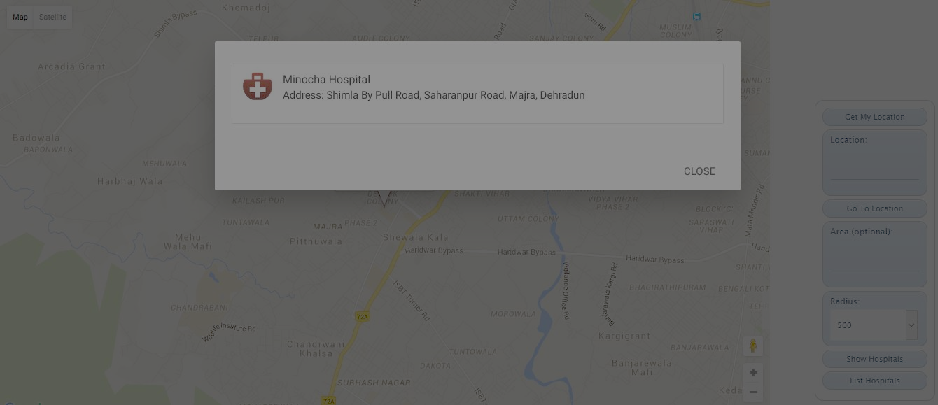
Medicare
List Hospitals nearby your Location within a desired radius.
List Hospitals nearby any place.
Display their Location On Google Maps

Slide 5
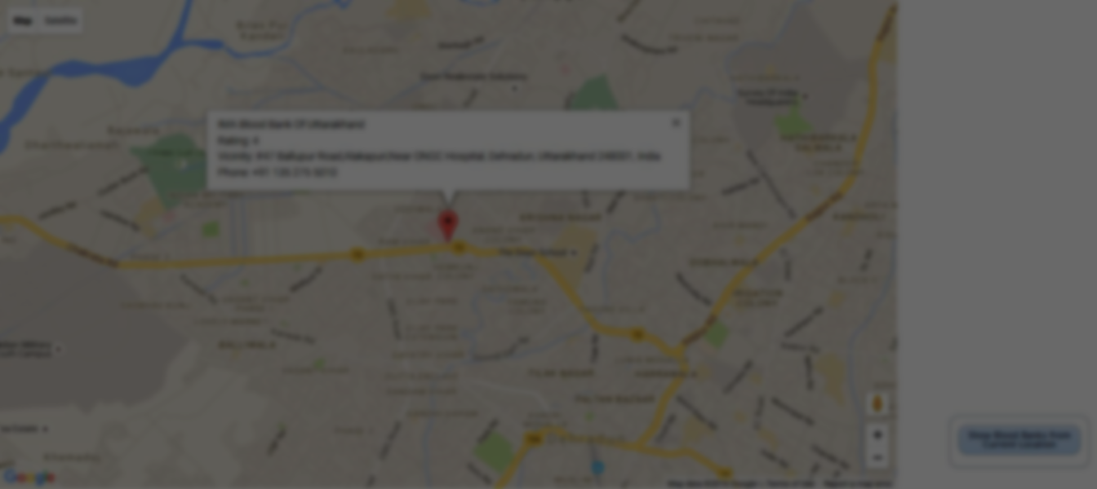
Blood Banks
List Blood Banks nearby your location
Display Result on Google Maps for User’s Convenience

Slide 6
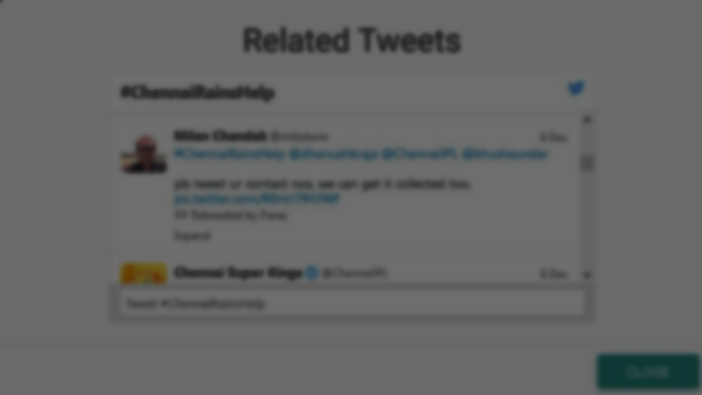
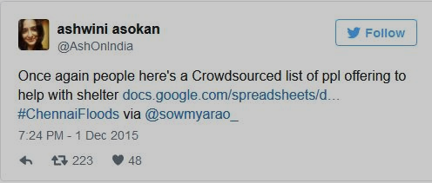
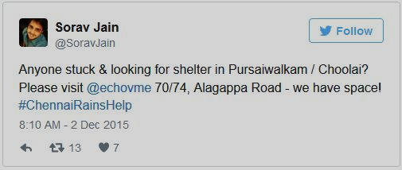
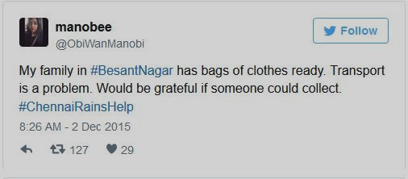
Twitter Feeds Related To Certain Calamity
We have seen that there is potential to use social media data from community members to help identify hotspots in need of aid.
We Integrated twitter feed so that average people can connect to the global network and can avail social/moral/financial support that they crave for at such harsh times.

Slide 7
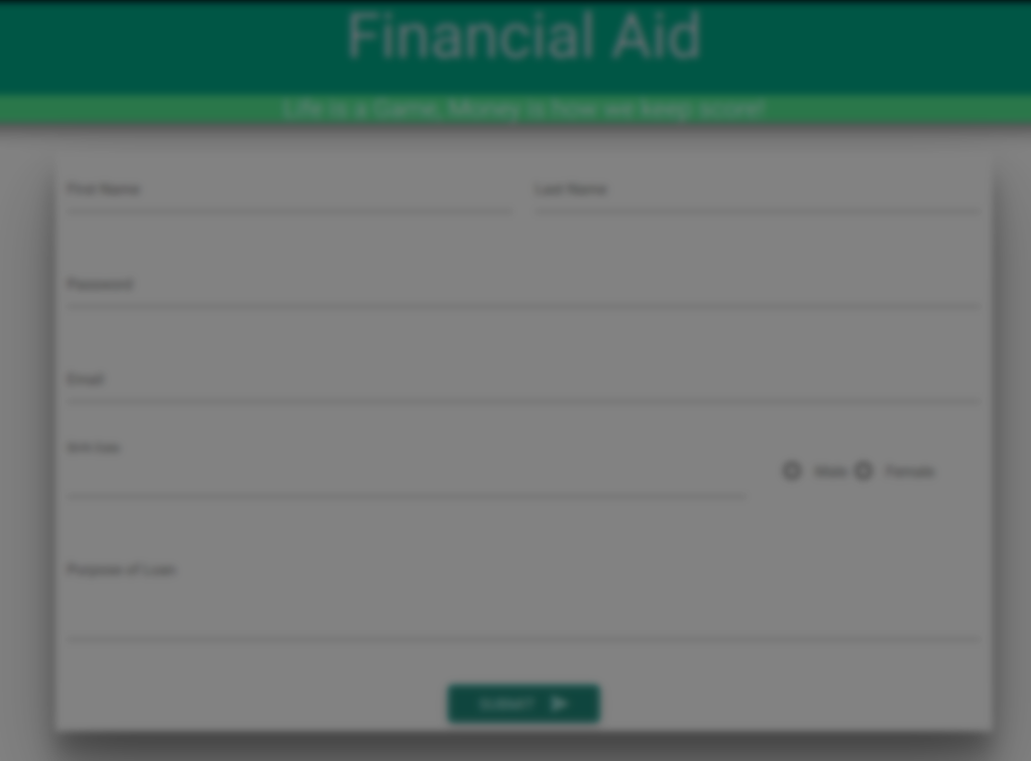
Financial Aid
If you are affected by disaster and need some financial support, you can request for a loan.
Your request will be recorded and will be provided to those who can really help you.
We are ready to help you anytime.

Slide 8
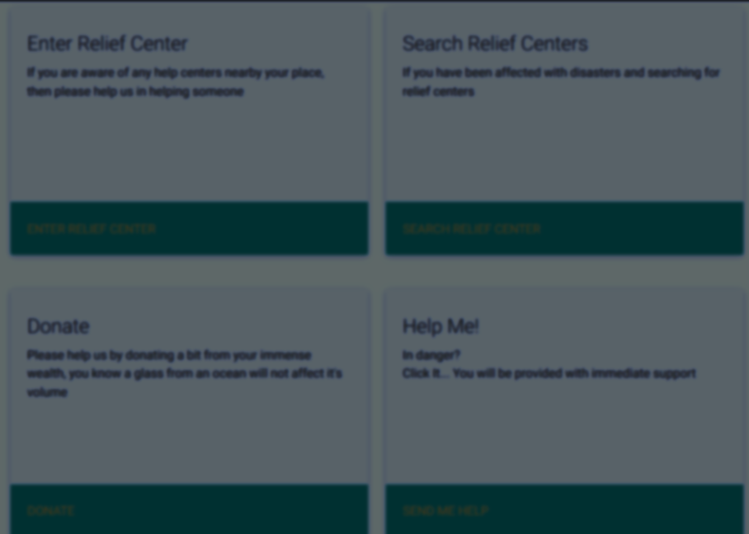
SOS :- When Disaster Hits
Enter Relief Centers
List Relief Centers
Donate
Help Me!!

Slide 9
Enter Relief Center
If you are willing to provide any kind of help, be it shelter,food,water or anything that can be aid to disaster hit people you can provide details.
If you know a place where government based relief centers are located, you can provide it’s details so that it can help people.
As they say “Humans Help Humans” .

Slide 10
Search Relief Centers
Struck somewhere in Disaster hit area ? Don’t know where to go? Check out Relief Centers Nearby
There are many people who are ready to help you, we have them listed for you. Avail the help.
Get Safe..

Slide 11
Donate :-
As it is said “Doing Good Deed Is Man’s Most Glorious Task”. Do some good by donating something to help those in need. Be it your electronic items or clothes or a small amount of money.

Slide 12
SOS :-
It is heart of our application, where you can save your life
1 SMS = 1 Life
If struck somewhere badly and no one is to help you. Send an SMS to +1 205-660-2113 as
RELIEF <PIN Code> <Address>
Your response will be recorded and based on your details help will be reach you as soon as possible.

Slide 13
Thankyou!!
An initiative by Giddions.
(Amit Phulera | Manthan Jamdagni | Nitin Pathak )

